Slide 1
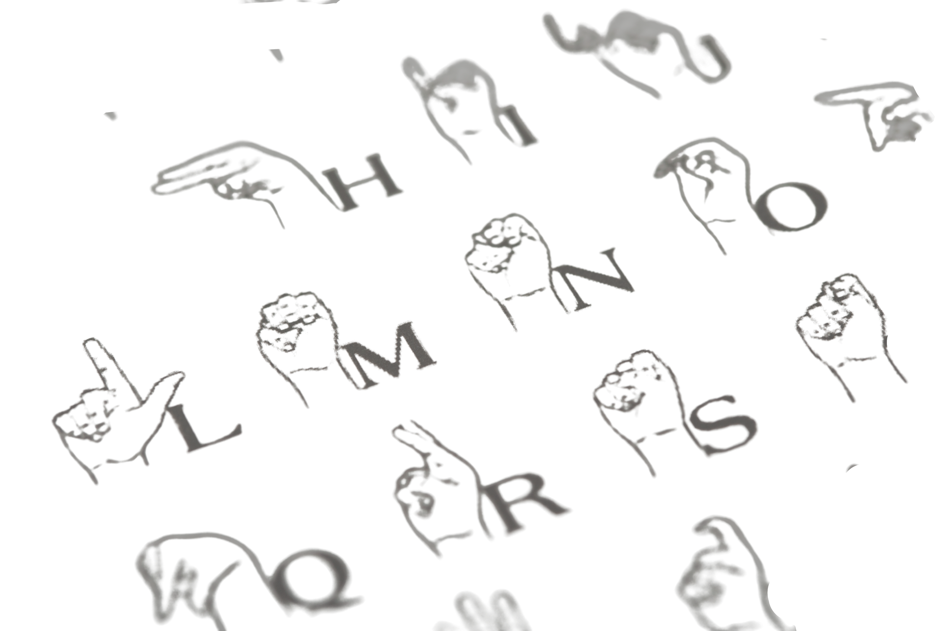
MACHINE LEARNING BASED
SIGN LANGUAGE RECOGNIGATION
PRESENTED BY
Abhinav Jha
Abhinav Kashyap
Ruchika Yadav
Spandan Das

Slide 2
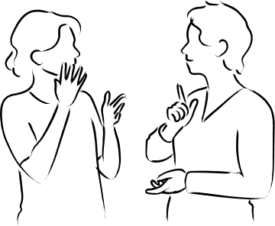
Project
Overview
Sign language, a rich and expressive method of communication for the deaf population, is being revolutionized by technology. MediaPipe and OpenCV are being used to recognize and comprehend hand movements, translating sign language into text or speech. This innovative technology has the potential to transform the lives of hard of-hearing and deaf people, enhancing communication in various fields such as accessibility, healthcare, and education. In this project, we tried to contribute an innovative way to convert sign language to speech.

Slide 3
How to convert sign language into text or speech

Slide 4
How to convert sign language into text or speech
DEEP LEARNING MODELS

Slide 5
How to convert sign language into text or speech
DEEP LEARNING MODELS
FEATURE EXTRACTION

Slide 6
How to convert sign language into text or speech
DEEP LEARNING MODELS
FEATURE EXTRACTION
BACKGROUND SUBTRACTION

Slide 7
How to convert sign language into text or speech
DEEP LEARNING MODELS
FEATURE EXTRACTION
BACKGROUND SUBTRACTION
3D IMAGE RENDERING

Slide 8
How to convert sign language into text or speech
DEEP LEARNING MODELS
FEATURE EXTRACTION
BACKGROUND SUBTRACTION
3D IMAGE RENDERING
GESTURE RECOGNITION API’s

Slide 9
Detecting hands in the images using hand detection API
Normalizing and plotting curves for each letter
2
4
Objective
3
Extracting Landmarks from the captured image
Calculating the statistical error for character prediction
1

Slide 10
Normalizing and plotting curves for each letter
2
4
Objective
1
Detecting hands in the images using hand detection API
3
Extracting Landmarks from the captured image
Calculating the statistical error for character prediction

Slide 11
Normalizing and plotting curves for each letter
4
Objective
Extracting Landmarks from the captured image
1
Detecting hands in the images using hand detection API
2
3
Calculating the statistical error for character prediction

Slide 12
4
Objective
Extracting Landmarks from the captured image
1
3
Detecting hands in the images using hand detection API
Normalizing and plotting curves for each letter
2
Calculating the statistical error for character prediction

Slide 13
Objective
Extracting Landmarks from the captured image
Calculating the statistical error for character prediction
1
3
Detecting hands in the images using hand detection API
Normalizing and plotting curves for each letter
2
4

Slide 14
STEP 1
Detecting hands in the images using hand detection API

Slide 15
Mediapipe
&
OpenCV

Slide 16
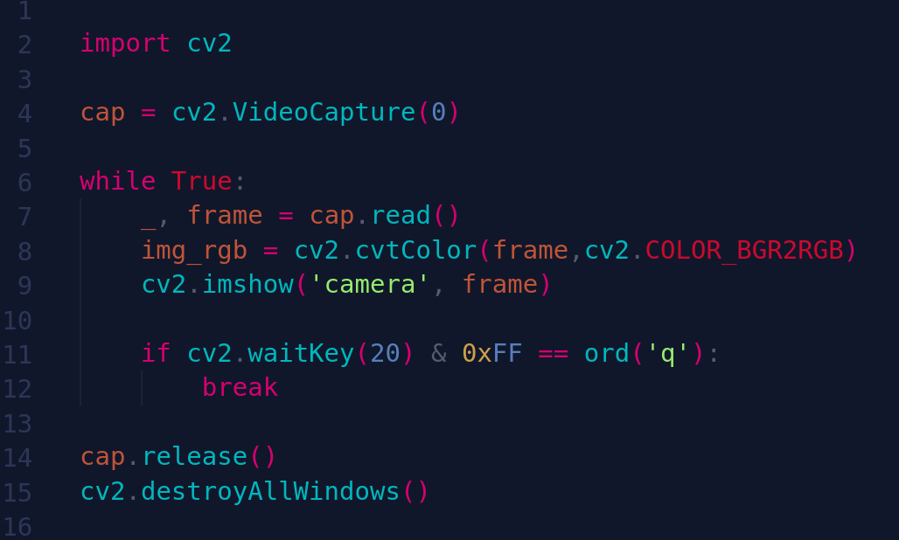
OpenCV
Mediapipe

Slide 17
OpenCV
Mediapipe

Slide 18
OpenCV
Mediapipe

Slide 19
OpenCV
Mediapipe

Slide 20
OpenCV
Mediapipe

Slide 21
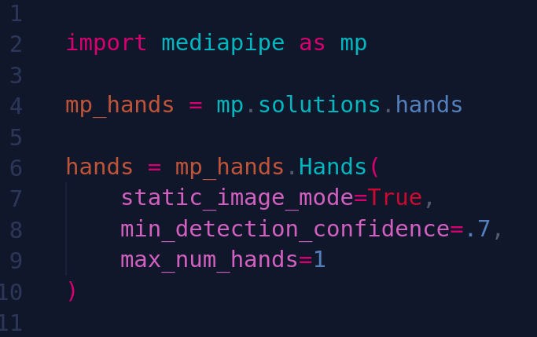
OpenCV
Mediapipe

Slide 22
OpenCV
Mediapipe

Slide 23
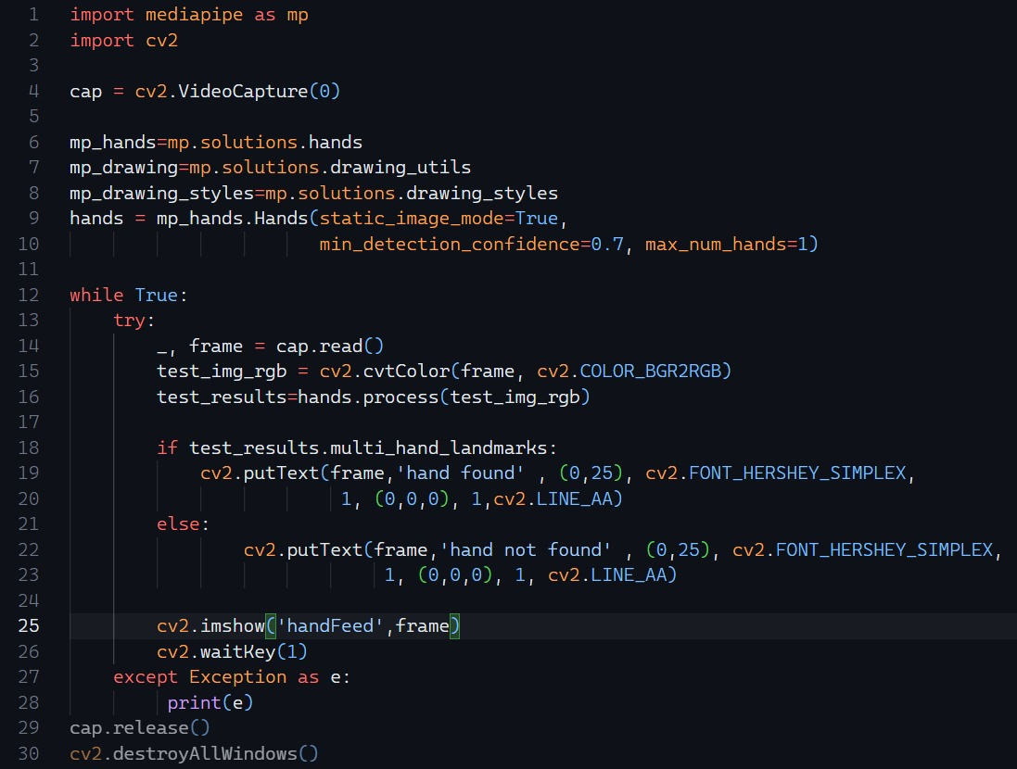
OpenCV
Mediapipe

Slide 25
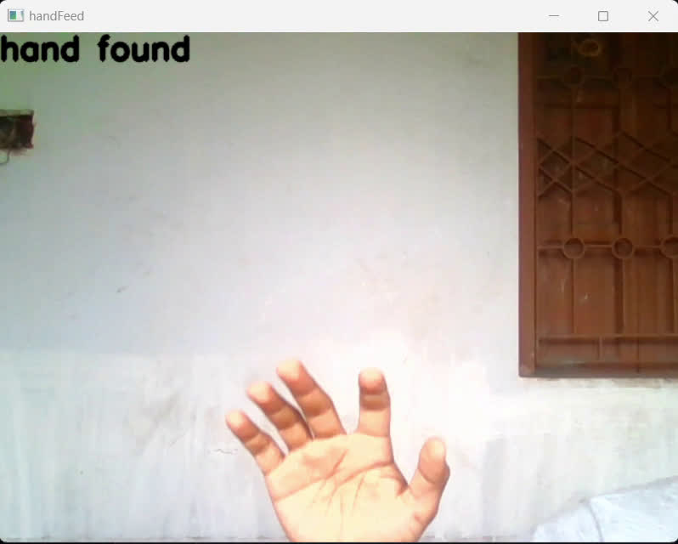

Slide 26
STEP 2
Extracting Landmarks from the captured image

Slide 27
Mediapipe
Hand landmark
Extraction

Slide 28
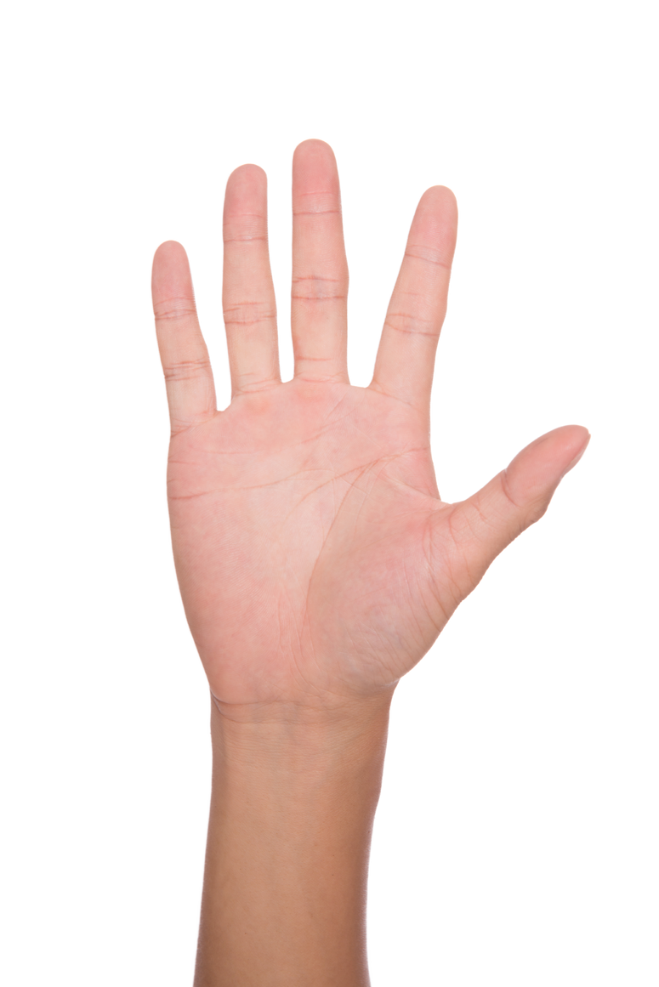
Mediapipe
Hand landmark
Extraction

Slide 29
Mediapipe
Hand landmark
Extraction

Slide 30
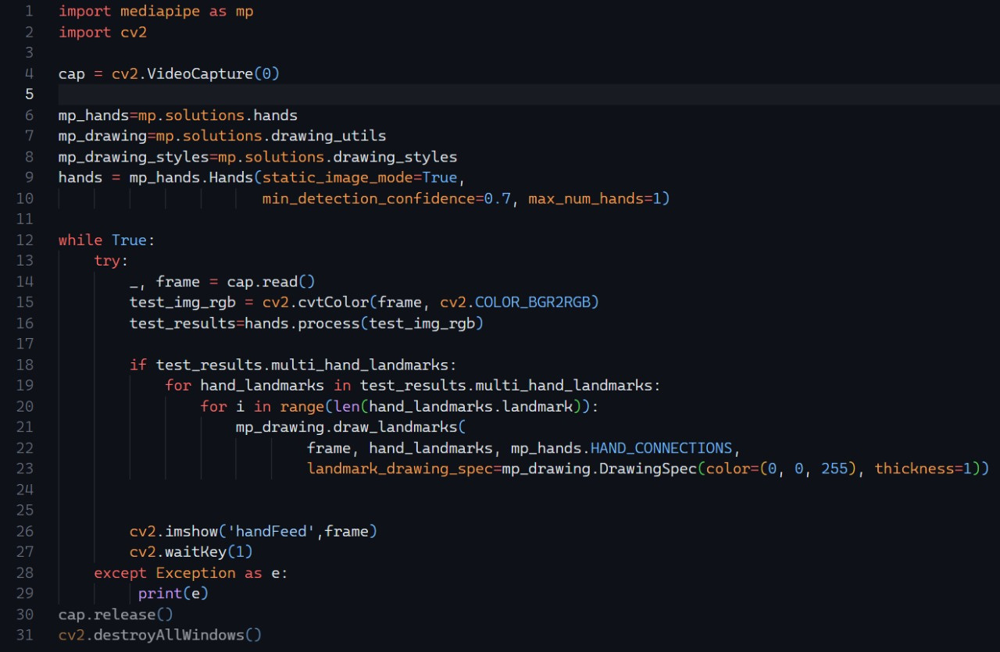
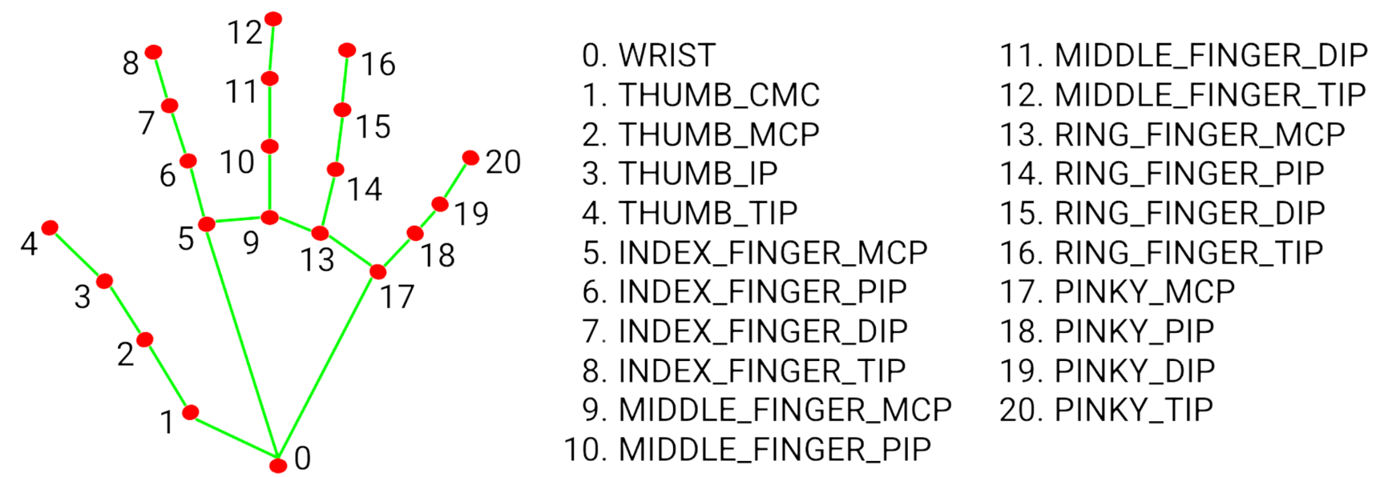
Mediapipe
Hand landmark
Extraction

Slide 32
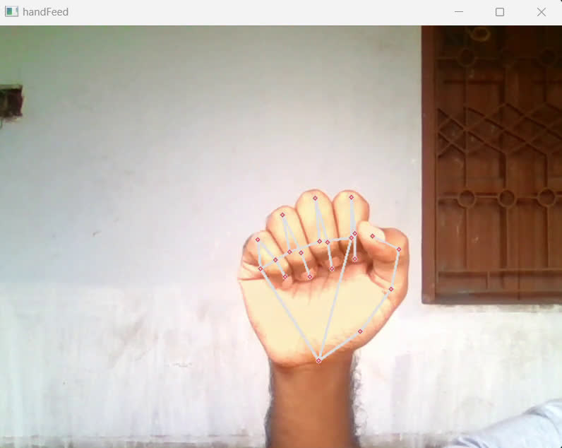

Slide 33
STEP 3
Normalizing and plotting curves for each letter

Slide 34
American Sign language for alphabets

Slide 35
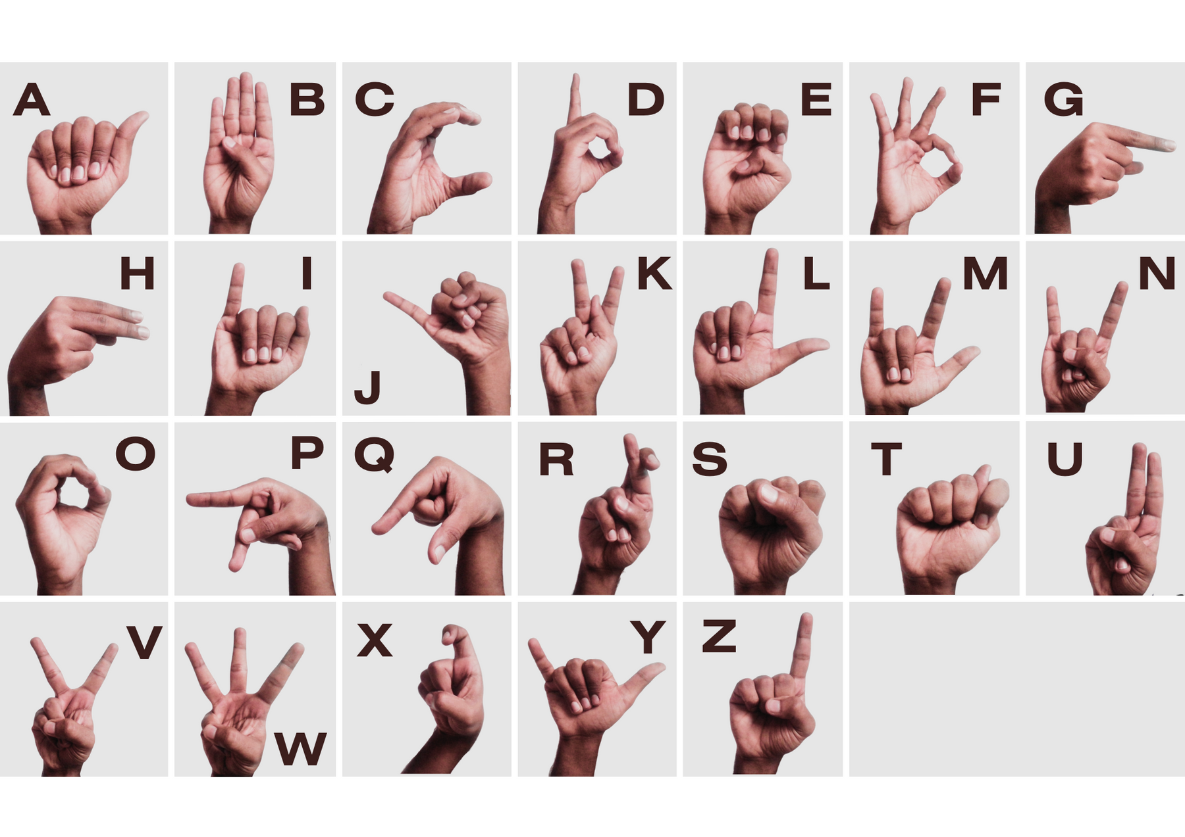
American Sign language for alphabets

Slide 36
Distinct difference of landmarks for each hand-signs

Slide 37
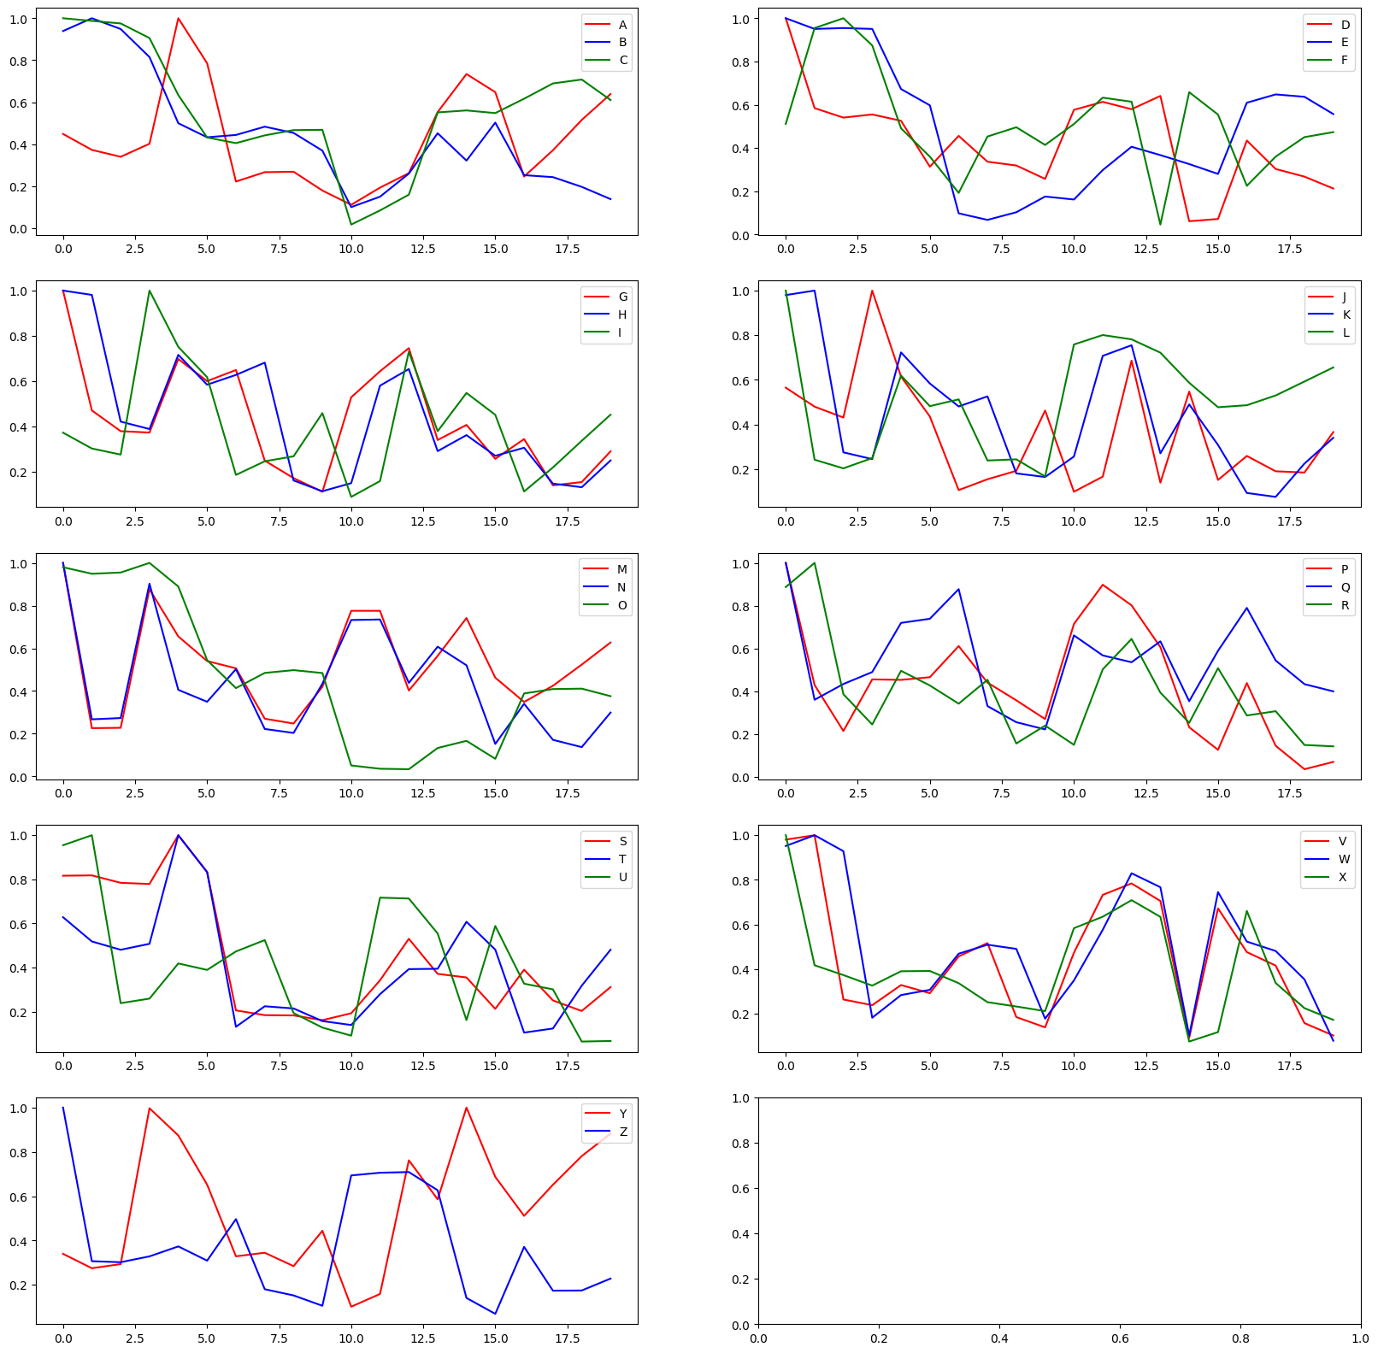
Distinct difference of landmarks for each hand-signs

Slide 38
Distinct difference of landmarks for each hand-signs

Slide 39
Distinct difference of landmarks for each hand-signs

Slide 40
Distinct difference of landmarks for each hand-signs

Slide 41
Distinct difference of landmarks for each hand-signs

Slide 42
Distinct difference of landmarks for each hand-signs

Slide 43
STEP 4
Calculating the statistical error
for character prediction

Slide 44
How to recognize the hand-signs from livefeed ?

Slide 45
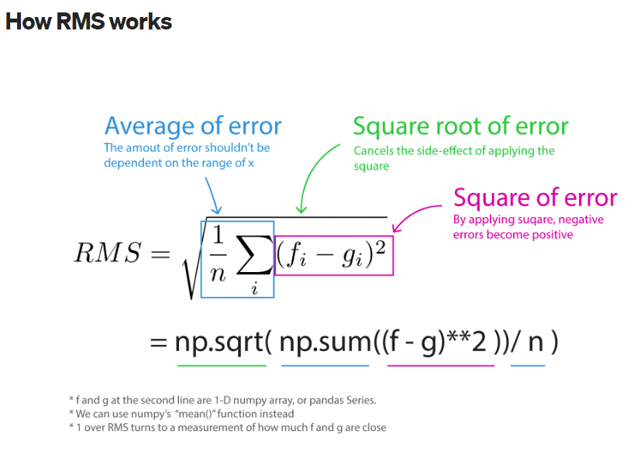
How to recognize the hand-signs from livefeed ?
CURVE
FITTING
root mean square

Slide 46
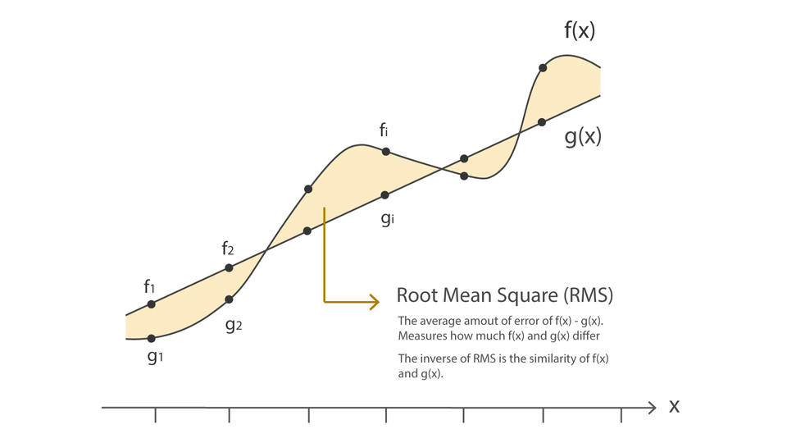
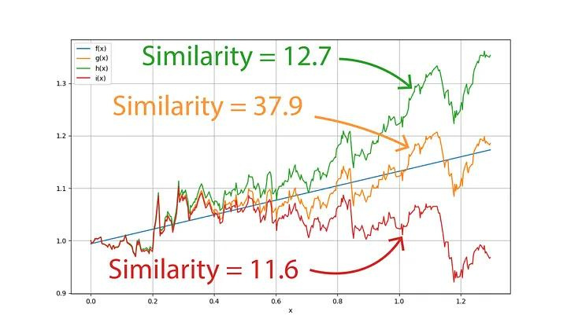
How to recognize the hand-signs from livefeed ?
root mean square
CURVE
FITTING

Slide 47
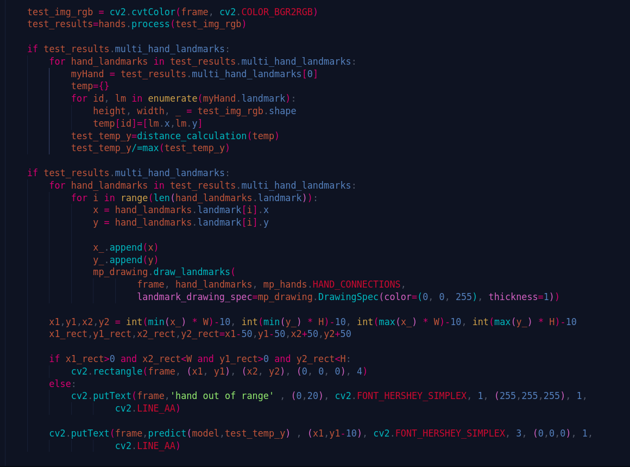
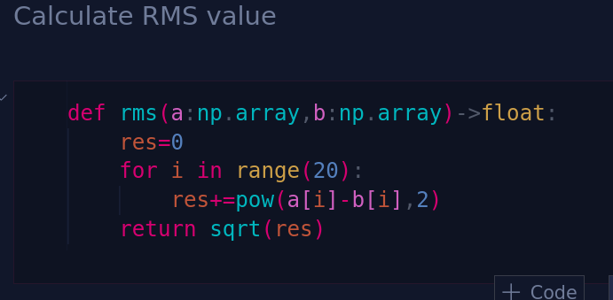
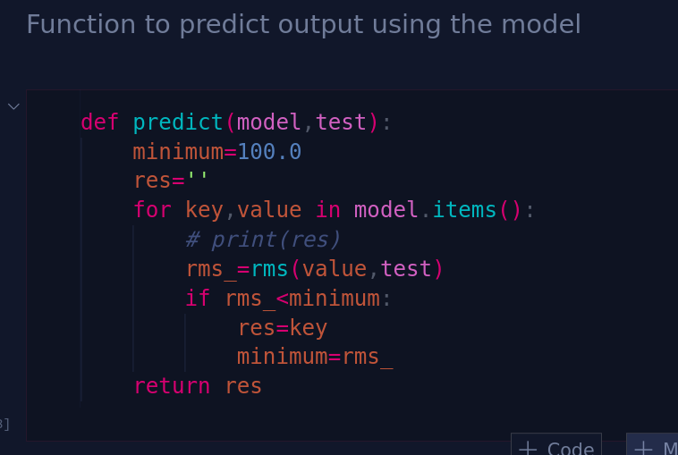
root mean square

Slide 48
root mean square

Slide 49
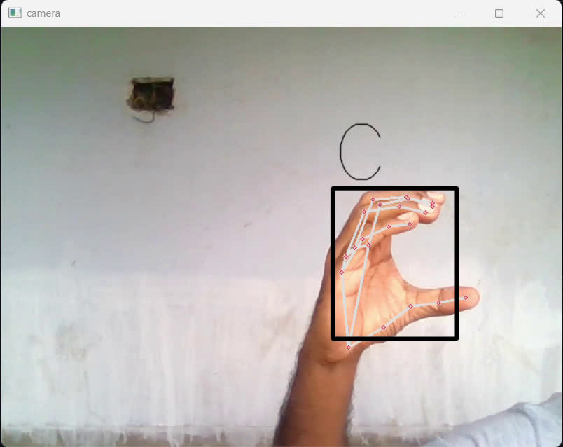
root mean square

Slide 50
Thank you

